Slide 1
Discrete Mathematics
Logic and Propositional Calculus

Slide 2
Logic
Logic is the basis of all mathematical reasoning, and of all automated reasoning
It has practical applications
To the design of computing machines
To the specification of systems
To artificial intelligence
To computer programming
To programming languages, and
To other areas of computer science, as well as to many other fields of study

Slide 3
Logic
To understand mathematics, we must understand what makes up a correct mathematical argument, that is, a proof .
Once we prove a mathematical statement is true, we call it a theorem
A collection of theorems on a topic organize what we know about this topic
Knowing the proof of a theorem often makes it possible to modify the result to ﬁt new situations

Slide 4
Propositional Logic
The rules of logic give precise meaning to mathematical statements
These rules are used to distinguish between valid and invalid mathematical arguments.

Slide 5
Propositional Logic
A proposition is a declarative sentence (that is, a sentence that declares a fact) that is either true or false, but not both

Slide 6
Propositional Logic
All the following declarative sentences are propositions.
Washington, D.C., is the capital of the United States
Toronto is the capital of Canada.
1 + 1 = 2.
2 + 2 = 3.
Propositions 1 and 3 are true, whereas 2 and 4 are false

Slide 7
Propositional Logic
Some sentences that are not propositions are given below:
What time is it?
Read this carefully
x + 1 = 2.
x + y = z
Sentences 1 and 2 are not propositions because they are not declarative sentences
Sentences 3 and 4 are not propositions because they are neither true nor false

Slide 8
Propositional Logic
We use letters to denote propositional variables (or statement variables), that is, vari-
ables that represent propositions
The conventional letters used for propositional variables are p, q, r, s,... .
The truth value of a proposition is true, denoted by T, if it is a true proposition, and the truth value of a proposition is false, denoted by F, if it is a false proposition.

Slide 9
Propositional Logic
The area of logic that deals with propositions is called the propositional calculus or propositional logic.
It was ﬁrst developed systematically by the Greek philosopher Aristotle more than 2300 years ago.

Slide 10
Propositional Logic
Compound Propositions
Many mathematical statements are constructed by combining one or more propositions. New propositions, called compound propositions, are formed from existing propositions using logical operators
Primitive Proposition
A proposition is said to be primitive if it can not be broken down into simpler proposition

Slide 11
Propositional Logic
Basic Logical Operation
Negation
Conjunction
Disjunction

Slide 12
Propositional Logic
Negation
Let p be a proposition. The negation of p, denoted by ¬p, is the statement
“It is not the case that p.”
The proposition ¬p is read “not p.” The truth value of the negation of p, ¬p, is the opposite
of the truth value of p.

Slide 13
Propositional Logic
Negation
Find the negation of the proposition
“Michael’s PC runs Linux”
The negation is
“It is not the case that Michael’s PC runs Linux.”
This negation can be more simply expressed as
“Michael’s PC does not run Linux.”

Slide 14
Propositional Logic
Negation
Find the negation of the proposition
“Vandana’s smartphone has at least 32GB of memory”
(and express this in simple English)
The negation is
“It is not the case that Vandana’s smartphone has at least 32GB of memory.”

Slide 15
Propositional Logic
Negation
This negation can also be expressed as
“Vandana’s smartphone does not have at least 32GB of memory”
or even more simply as
“Vandana’s smartphone has less than 32GB of memory.”

Slide 16
Propositional Logic
Negation
Table displays the truth table for the negation of a proposition p
The Truth Table for the Negation of a Proposition.
p | ¬p
T | F
F | T

Slide 17
Propositional Logic
Negation
The negation of a proposition can also be considered the result of the operation of the
negation operator on a proposition
The negation operator constructs a new proposition from a single existing proposition

Slide 18
Propositional Logic
There are logical operators that are used to form new propositions from two or more existing propositions. These logical operators are called connectives.

Slide 19
Propositional Logic
Conjunction
Let p and q be propositions. The conjunction of p and q, denoted by p ∧ q, is the proposition
“p and q.” The conjunction p ∧ q is true when both p and q are true and is false otherwise.
The Truth Table for the Conjunction of Two Propositions.
p | q | p ∧ q
F | F | F
F | T | F
T | F | F
T | T | T

Slide 20
Propositional Logic
Conjunction
p = “Rebecca’s PC has more than 16 GB free hard disk space”
q = “The processor in Rebecca’s PC runs faster than 1 GHz.”
p ∧ q = “Rebecca’s PC has more than 16 GB free hard disk space, and its processor runs faster than 1 GHz.”

Slide 21
Propositional Logic
Disjunction
Let p and q be propositions. The disjunction of p and q, denoted by p ∨ q, is the proposition
“p or q.” The disjunction p ∨ q is false when both p and q are false and is true otherwise.
The Truth Table for the Disjunction of Two Propositions.
p | q | p ∨ q
F | F | F
F | T | T
T | F | T
T | T | T

Slide 22
Propositional Logic
Disjunction
p = “Rebecca’s PC has more than 16 GB free hard disk space”
q = “The processor in Rebecca’s PC runs faster than 1 GHz.”
p ∨ q = “Rebecca’s PC has more than 16 GB free hard disk space, or its processor runs faster than 1 GHz.”

Slide 23
Propositional Logic
Exclusive Or
Let p and q be propositions. The exclusive or of p and q, denoted by p ⊕ q, is the proposition
that is true when exactly one of p and q is true and is false otherwise.
The Truth Table for the Exclusive Or of Two Propositions.
p | q | p ⊕ q
F | F | F
F | T | T
T | F | T
T | T | F

Slide 24
Propositional Logic
Tautology
A propositional expression is a tautology if and only if for all possible assignments of truth values to its variables its truth value is T
p | ¬p | p ∨ ¬p
F | T | T
T | F | T

Slide 25
Propositional Logic
Contradiction
A propositional expression is a Contradiction if and only if for all possible assignments of truth values to its variables its truth value is F
p | ¬p | p ∧ ¬p
F | T | F
T | F | F

Slide 26
Propositional Logic
Conditional Statement
Let p and q be propositions. The conditional statement p → q is the proposition “if p, then q.” The conditional statement p → q is false when p is true and q is false, and true otherwise.
In the conditional statement p → q, p is called the hypothesis (or antecedent or premise) and q is called the conclusion (or consequence).

Slide 27
Propositional Logic
Conditional Statement
The Truth Table for the Conditional Statement p → q
p | q | p → q
F | F | T
F | T | T
T | F | F
T | T | T

Slide 28
Propositional Logic
Conditional Statement
Different ways to express conditional statement:
“if p, then q” “p implies q”
“if p, q” “p only if q”
“p is sufﬁcient for q” “a sufﬁcient condition for q is p”
“q if p” “q whenever p”
“q when p” “q is necessary for p”
“a necessary condition for p is q”
“q follows from p”
“q unless ¬p”
“p only if q” says that p cannot be true when q is not true

Slide 29
Propositional Logic
Conditional Statement
Let p be the statement “Maria learns discrete mathematics” and q the statement “Maria will ﬁnd a good job.” Express the statement p → q as a statement in English
p is the statement “Maria learns discrete mathematics” and q is the statement “Maria will ﬁnd a good job,”
p → q
represents the statement
“If Maria learns discrete mathematics, then she will ﬁnd a good job.”

Slide 30
Propositional Logic
Conditional Statement
There are many other ways to express this conditional statement in English. Among the most natural of these are:
“Maria will ﬁnd a good job when she learns discrete mathematics.”
“For Maria to get a good job, it is sufﬁcient for her to learn discrete mathematics.”
and
“Maria will ﬁnd a good job unless she does not learn discrete mathematics.”

Slide 31
Propositional Logic
Biconditional Statement
Let p and q be propositions. The biconditional statement p ↔ q is the proposition “p if and only if q.” The biconditional statement p ↔ q is true when p and q have the same truth values, and is false otherwise. Biconditional statements are also called bi-implications.

Slide 32
Propositional Logic
Biconditional Statement
The Truth Table for the Biconditional Statement of p ↔ q
p | q | p ↔ q
F | F | T
F | T | F
T | F | F
T | T | T

Slide 33
Propositional Logic
Biconditional Statement
Note that the statement p ↔ q is true when both the conditional statements p → q and q → p are true and is false otherwise. That is why we use the words “if and only if” to express this logical connective and why it is symbolically written by combining the symbols → and ←.
There are some other common ways to express p ↔ q:
“p is necessary and sufﬁcient for q”
“if p then q, and conversely”
“p iff q.”

Slide 34
Propositional Logic
Biconditional Statement
Let p be the statement “You can take the ﬂight,”
and
let q be the statement “You buy a ticket.”
Then p ↔ q is the statement
“You can take the ﬂight if and only if you buy a ticket.”

Slide 35
Propositional Logic
Biconditional Statement
Construct the truth table of the compound proposition
(p ∨¬q) → (p ∧ q).

Slide 36
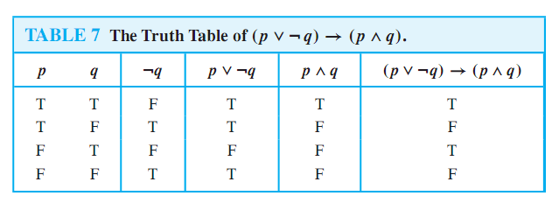
Propositional Logic
Biconditional Statement

Slide 37
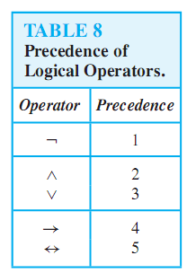
Propositional Logic
Precedence of Logical Operators

Slide 38
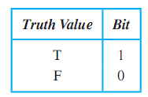
Propositional Logic
Logic and Bit Operations

Slide 39
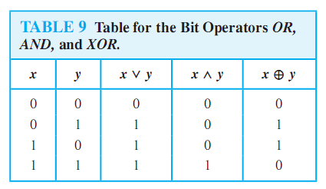
Propositional Logic
Logic and Bit Operations

